Slide 1

Undergraduate Program in
Biomedical Engineering
Kim Paige
Freshmen Undergraduate Academic Advisor
Email: kim.paige@bme.gatech.edu
Kristen Laquidara
Sophomore Undergraduate Academic Advisor
Email: kristen.laquidara@bme.gatech.edu
Paul Fincannon
Academic Advising Manager
Junior / Senior / Transfer Undergraduate Academic Advisor
Email: paul.fincannon@bme.gatech.edu
Sally Gerrish
Manager- Student, Alumni and Industrial Relations
Email: sally.gerrish@bme.gatech.edu

Slide 2
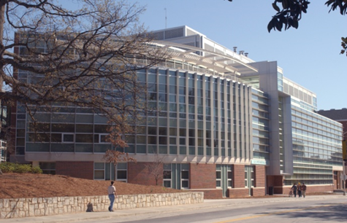
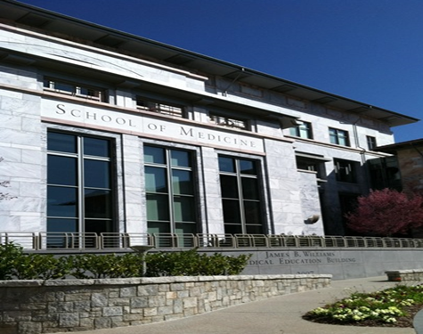
B.S. BMED (GT)
School within the College of Engineering @ Georgia Tech
BioID Masters (GT)
Ph.D. (GT/EU)
Department within the School of Medicine @ Emory University
Organizational Structure & Degree Programs

Slide 3


Fall 2014 Enrollment
~1316 undergraduate students
~182 graduate students
~388 new students (204 women/53%)
Degrees Awarded 2013-2014
  230 Bachelor Degrees
  (141 males/89 females)
  19 Doctoral Degrees
  (12 males/7 female)
Class Size

Slide 4
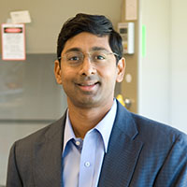
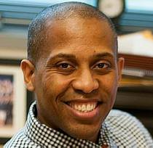
Created in 1997
First Undergraduate graduating class in 2004
Largest BME department in the United States
49 Primary BME faculty
Undergraduate program currently ranked 4th *
Graduate program currently ranked 2nd *
Approximately 40% of students change majors
72% of BMEs have done research
42% of BMEs have co-oped/interned
18% of BMEs have studied abroad
* US News and World Report
Department Chair
Dr. Ravi Bellamkonda
Associate Chair for
Undergraduate Studies
Dr. Ed Botchwey
GT Department Overview

Slide 5

Biomedical engineers contribute to the research, development and application of innovative approaches, materials, biologics and devices for the prevention, diagnosis and treatment of disease

Slide 6
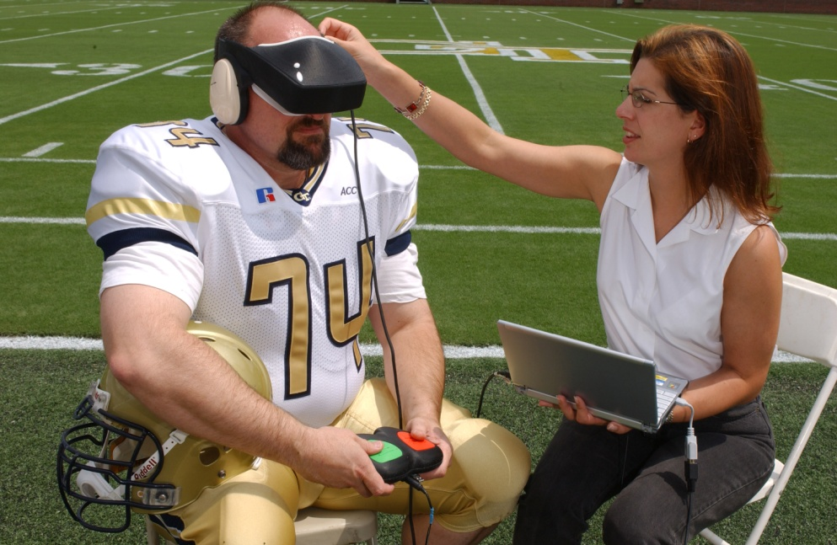
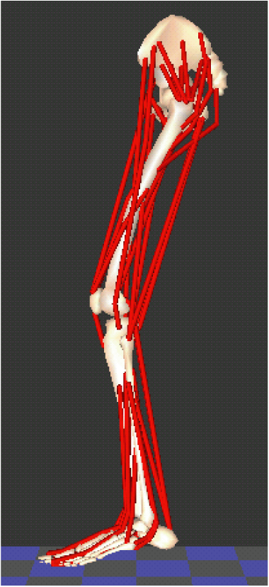
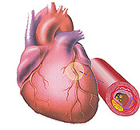
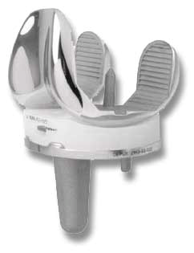
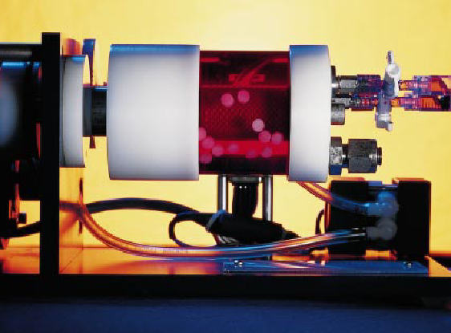
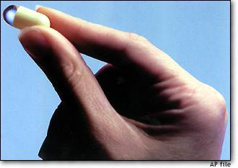
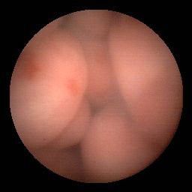
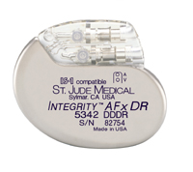
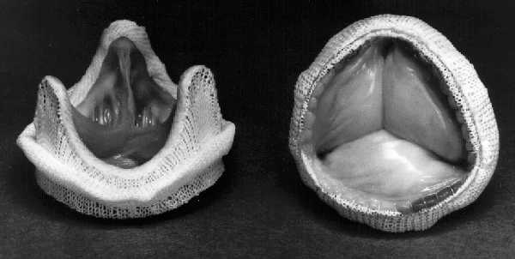
Neuroengineering
Biomechanics
Cell and Tissue
Engineering
Imaging
Biomaterials
Bioinstrumentation
BME Research
Notes:
Jessica Millsap

Slide 7
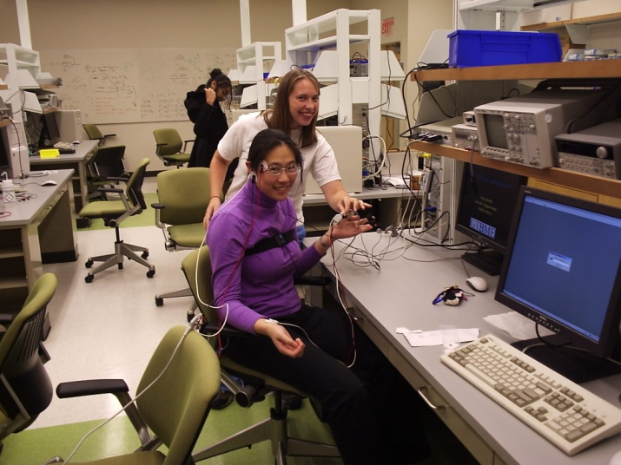
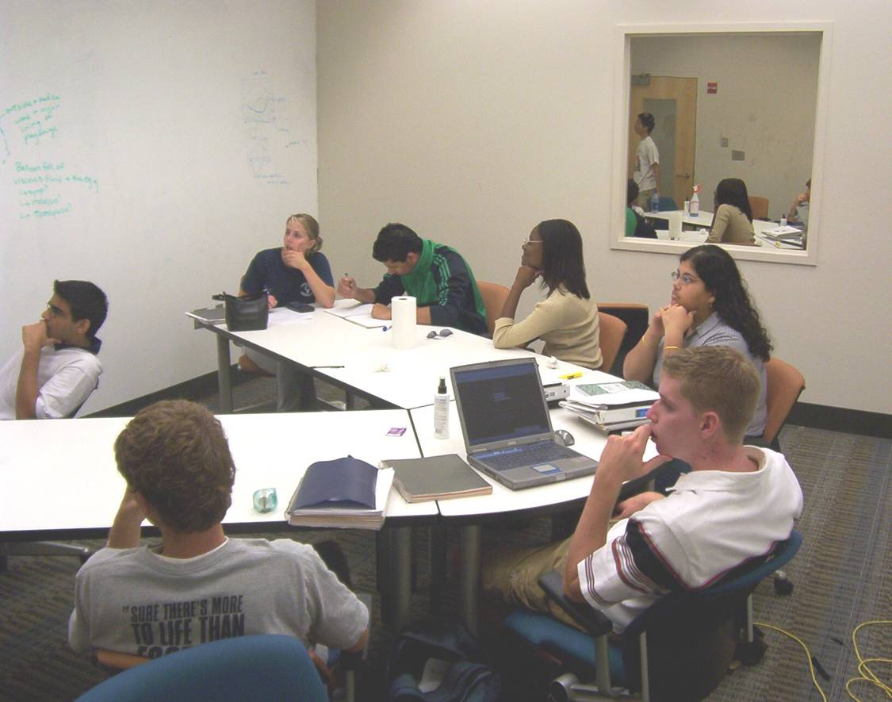
An educational approach that fosters the development of cognitive flexibility when students are challenged with solving the right kind of problems
Problem-Based Learning
Notes:
Cognitive flexibility is the capability of looking at problems from a variety of perspectives
To foster the development of truly innovative and integrative thinkers, problems are needed that demand quantitative engineering skills, as well as bioscience understanding and the ability to see the implied clinical applications.
Mention need to repeat these PBL exercises to develop expertise
First step in developing self-directed learning skills
7

Slide 8
Required Engineering and Science Courses (78 hours)
CHEMISTRY & MATH |  |  | MAJOR COURSES |  |  | PHYSICS, CS, SCIENCES/ENGINEERING
CHEM 1211K* | (4) |  | BMED 2210 | (4) |  | PHYS 2211 | (4)
CHEM 1315/2312 | (3) |  | BMED 2250 | (3) |  | PHYS 2212 | (3)
 |  |  | BMED 2310 | (3)
MATH 1551 | (2) |  | BMED 3100 | (3) |  | CS 1371 | (3)
MATH 1552 | (4) |  | BMED 3110 | (2)
MATH 1553 | (2) |  | BMED 3310 | (3) |  | COE 2001 | (2)
MATH 2551 | (4) |  | BMED 3400 | (4) |  | MSE 2001 | (3)
MATH 2552 | (4) |  | BMED 3520 | (3) |  | ECE 3710 | (2)
 |  |  | BMED 3600 | (3) |  | ECE 3741 | (1)
ISyE/CEE 3770 or BMED 2400 | (3) |  | BMED 3610 | (2)
 |  |  | BMED 4602 | (3)
Degree Requirements
(131 Hours)

Slide 9
General Education Courses (26 hours)
Humanities |  | Social Sciences |  | Wellness (choose one)
ENGL 1101 | (3) | U.S. Perspective | (3) | APPH 1040
ENGL 1102 | (3) | _____________ | (3) | or
_____________ | (3) | _____________ | (3) | APPH 1050 (2)
_____________ | (3) | _____________ | (3)
HIST 2111/2112, POL 1101, PUBP 3000 or INTA 1200 satisfies the U.S. Perspective Overlay. At least one social science or humanities credit must meet the Global Perspective Overlay.

Slide 10
BME Depth Electives (Select up to 12 hours)
BMED 4400 | (4) |  | BMED 4752 | (3) |  | BMED 4784 (3)
BMED 4477 | (3) |  | BMED4757 | (3) |  | ECE 3710 (3)
BMED 4500 | (3) |  | BMED 4758 | (3) |  | ECE 3741 (3)
BMED 4603 | (3) |  | BMED 4765 | (3) |  | ECE 2025/2026 (3)
BMED 4750 | (3) |  | BMED 4781 | (3) |  | *____________ (_)
BMED 4751 | (3) |  | BMED 4783 | (3) |  | *____________ (_)
BME Breath Electives (Must total 15 hours)
Pre-Health | Research Option | Minor | Certificate
CHEM 1212K (4) | LCC 4701 (1) | __________ (___) | ________ (___)
CHEM 2311 (3) | LCC 4702 (1) | __________ (___) | ________ (___)
CHEM 2380 (2) | _________ (3) | __________ (___) | ________ (___)
CHEM 3511 (3) | _________ (3) | __________ (___) | ________ (___)
__________ ( ) | _________ (3) _________ ( ) | __________ (___) | ________ (___)

Slide 11
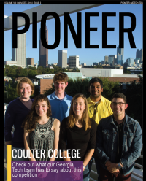



Alpha Eta Mu Beta
ENGINEERING
WORLD
HEALTH
BMED
FUTURES
bmedSAB
Student Organizations

Slide 12
Where Are Our Grads?

Slide 13
Field/Clinical Engineers
  Technical support to medical professionals, assist with the implantation of medical device and support of those devices
  e.g. St. Jude Medical, Medtronic, Boston Scientific, Stryker, Sorin
Product Development
  Designing, developing and testing new materials, devices and equipment
  e.g. Amendia, Edwards Lifesciences, CR Bard, Medshape Solutions, W.L.Gore
Process Development
  Devising new processes, or refining existing ones, to optimize the manufacturing process
  e.g. Baxter, Edwards Lifesciences, Kimberly-Clark, Johnson & Johnson, Abbott, Procter & Gamble
Consulting
  Provide clients with technology and business process expertise they may lack to help them make decisions
  e.g. Bain, Deloitte, Clarkston, Kurt Salmon, Pinnacle AIS, IBM
Fields/Positions in BME

Slide 14
Quality and Regulatory Affairs
Implement and maintain internal quality systems, support preparation of 510K applications, review of new product design, work closely with FDA
e.g. CR Bard, St. Jude Medical
Technical Sales
Determine how products could be designed or modified to meet customers’ needs and advise customers on how best to use the products
e.g. St Jude Medical, Zimmer, Beckman Coulter, Alpha Omega Engineering
Health IT
Develop and build software that helps healthcare organizations provide better care
e.g. Epic, McKesson, Meditech, Allscripts, Nuesoft
Government
Evaluate safety and effectiveness of medical devices, work with intellectual property, patents, research diseases
e.g. US Patent & Trademark Office, FDA, CDC
Fields/Positions in BME

Slide 15
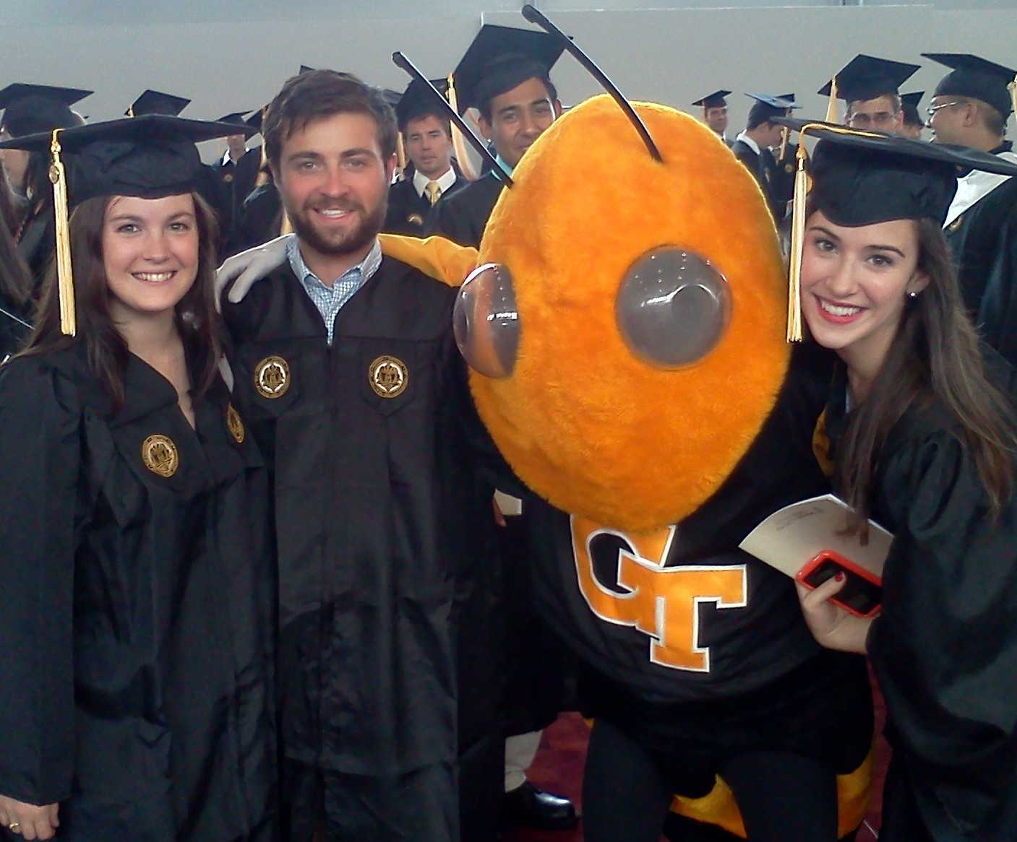
This could be you!

Slide 16


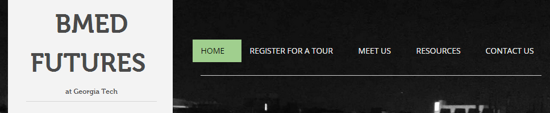
@AskABME
‘Like’ us to stay up-to-date
Visit us online at gtbmedfutures.wix.com/main
A different tour guide hosts our Twitter each week
Connect with Us!

Slide 17
Q & A

